Slide 1
Using Logistic Regression to build a predictive model for Customer Attritions, we concluded that the most significant factors are Total Revolving Balance, Credit Limit, Total Relationship Count, Total transactions Amount, Total Transactions Count, Total Amount Change and Total Count Change (Q1-Q4), Total Number of contacts and Inactivity duration in last 12 months, Avg Utilization Ratio, Education Level, and Income Category.
Key Insights:
Total Revolving Balance: Attrited Customers have a significantly lower avg total revolving balance ($673) vs. Existing customers ($1257), indicating that customers with low revolving balance are more likely to churn.
Credit Limit: Attrited Customers have lower credit limit than Existing customers, indicating that customers with lower credit limit are more likely to churn.
Total Relationship Count: Attrited Customers have lower number of products with the bank averaging (3.2) vs. Existing customers (3.9), indicating that customers having less products with the bank are more likely to churn.
Avg Utilization Ratio: Attrited Customers have lower Avg Utilization ratio than Existing customers, indicating that customers with lower avg credit utilization rate are more likely to churn.
Total Transactions Amount: Attrited Customers have lower avg total transaction amount ($3095) vs. Existing customers ($4655), indicating that customers with zero to low transaction amount are more likely to churn.
Total Transactions Count: Attrited Customers have lower avg total transaction count than Existing customers, indicating that customers with none to low transaction counts are more likely to churn.
Total Amount Change(Q1-Q4): Attrited Customers have lower % of change in total amount of transactions (66%) vs. Existing customers (77%), indicating that customers having none to few changes are more likely to churn.
Total Count Change(Q1-Q4): Attrited Customers have lower % of change in total count of transactions (55%) vs. Existing customers (74%), indicating that customers having none to few changes are more likely to churn.
Inactivity (last 12 months): Attrited Customers have a longer avg inactivity period (2.7 mons) vs. Existing customers
(2.3 mons) , indicating that customers with longer inactivity periods are more likely to churn.
Total Number of Contacts (last 12 months): Attrited Customers contacted the bank on average (2.9 times) in the last 12 mons vs. Existing customers (2.3 times), indicating that customers contacting the bank more frequent in the past 12 months are more likely to churn.
Education Level: Customers with Graduate education level represent (31%) of our customer base and have a (16%) attrition percentage , indicating that graduate customers are more likely to churn.
Income Category: Customers making <$40K represent (35%) of our customer base and have a (17%) attrition percentage, indicating that customers with such income are more likely to churn over other customers.

Slide 2
Numerical Variables T-test P-value

Slide 3
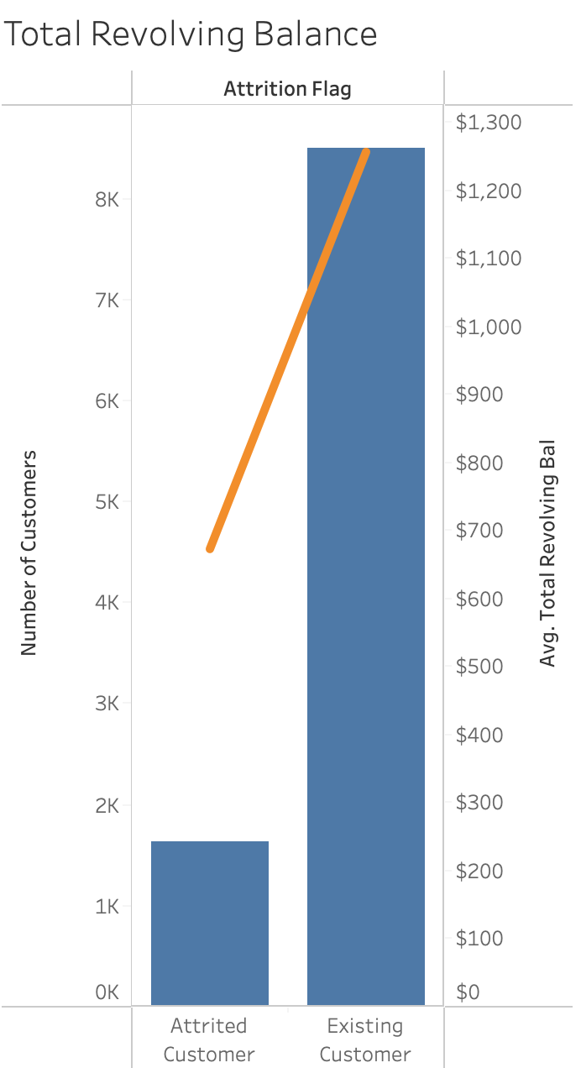
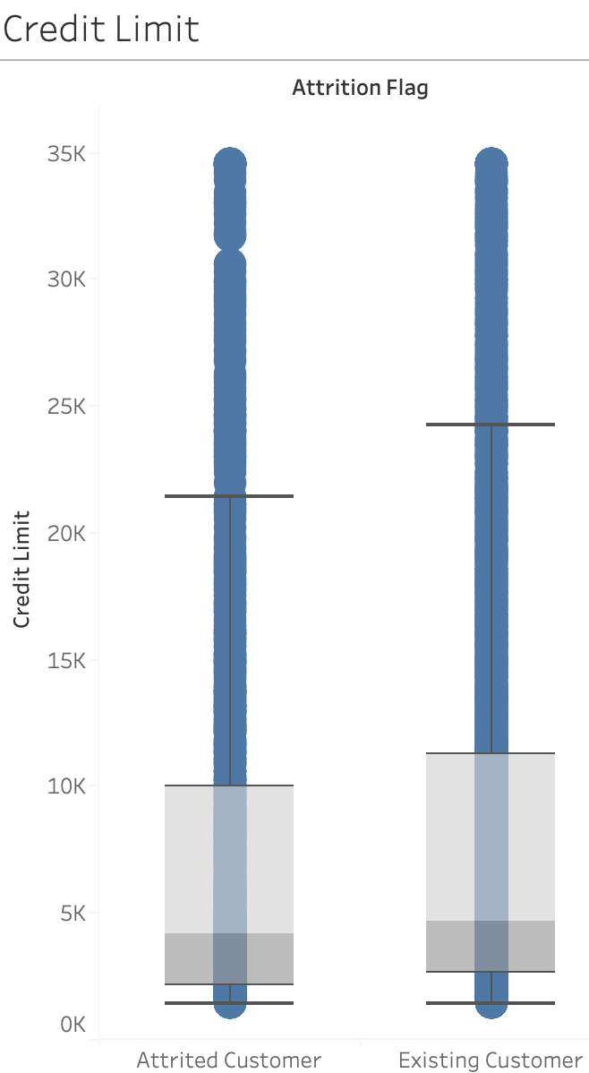
Total Revolving Balance
T stat is > t critical at 27.4 and p-value is < 0.05 indicating significance of total revolving balance in predicting attritions.
Average total revolving balance for Attrited customers ($673) is significantly lower than Existing customers ($1257), indicating that customers with low revolving balance are more likely to churn.
Credit Limit
T stat is > t critical at 2.4 and p-value is < 0.05 indicating significance of total revolving balance in predicting attritions.
Attrited Customers have lower values for credit limit than Existing customers, indicating that customers with lower credit limit are more likely to churn.

Slide 4
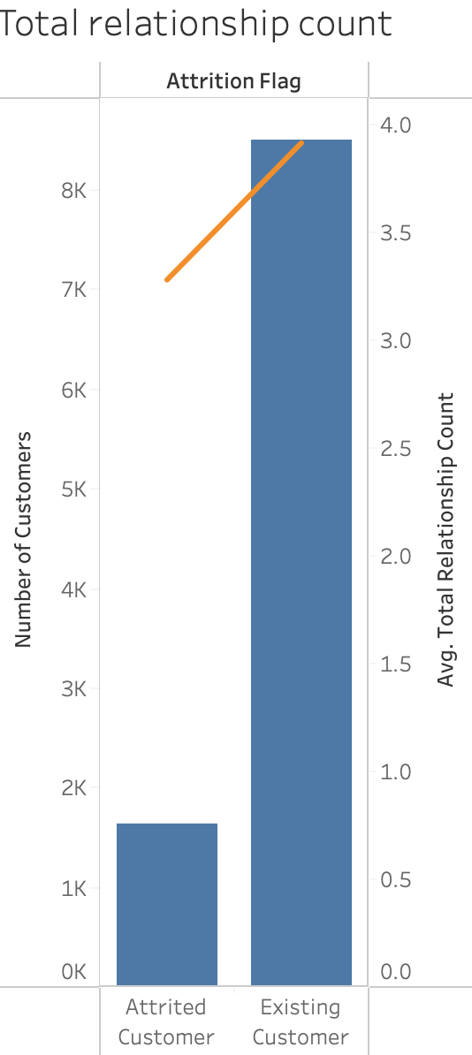
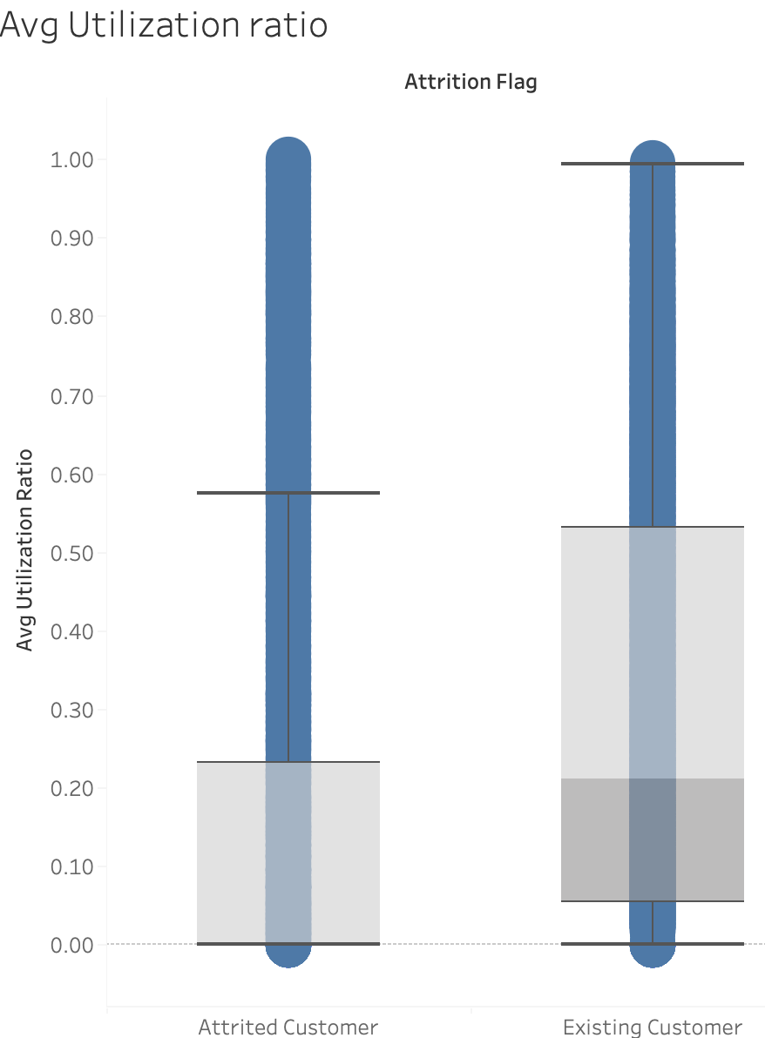
Total Relationship Count
T stat is > t critical at 15.2 and p-value is < 0.05 indicating significance of total relationship count in predicting attritions.
Attrited Customers have lower number of products with the bank averaging at (3.2) vs. Existing customers (3.9), indicating that customers having less products with the bank are more likely to churn.
Avg Utilization Ratio
T stat is > t critical at 18.2 and p-value is < 0.05 indicating significance of avg utilization ratio in predicting attritions.
Attrited Customers have lower values for Avg Utilization ratio than Existing customers, indicating that customers with lower avg credit utilization rate are more likely to churn.

Slide 5
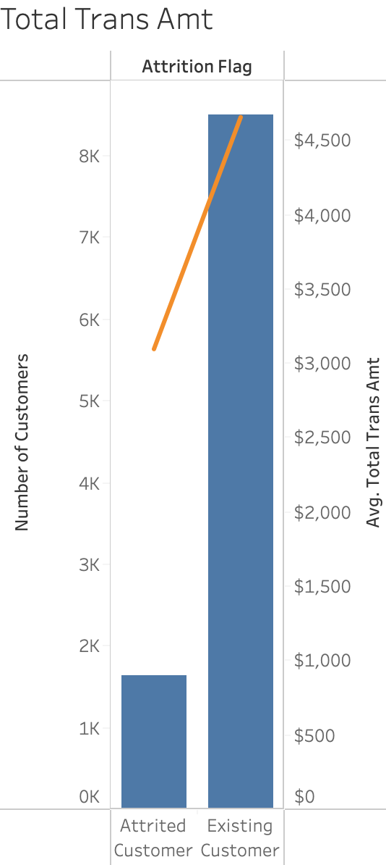
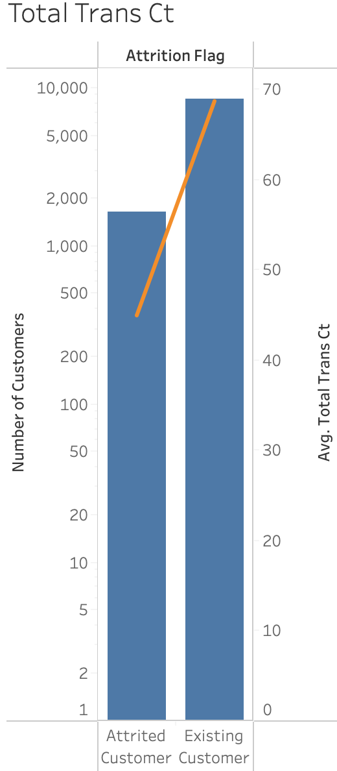
Total Transactions Amount
T stat is > t critical at 17.2 and p-value is < 0.05 indicating significance of total transactions amount in predicting attritions.
Attrited Customers have lower avg total transaction amount ($3095) vs. Existing customers ($4655), indicating that customers with zero to low transaction amount are more likely to churn.
Total Transactions Count
T stat is > t critical at 40.2 and p-value is < 0.05 indicating significance of total transactions count in predicting attritions.
Attrited Customers have lower avg total transaction count (44.9) vs. Existing customers (68.7), indicating that customers with none to low transaction counts are more likely to churn.

Slide 6
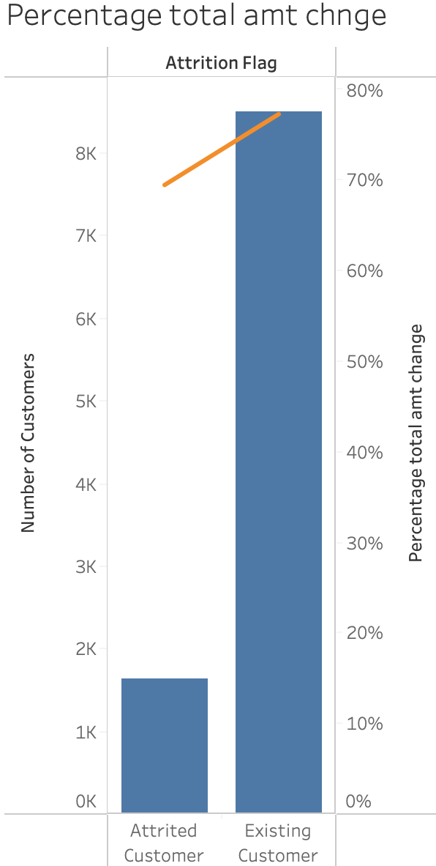
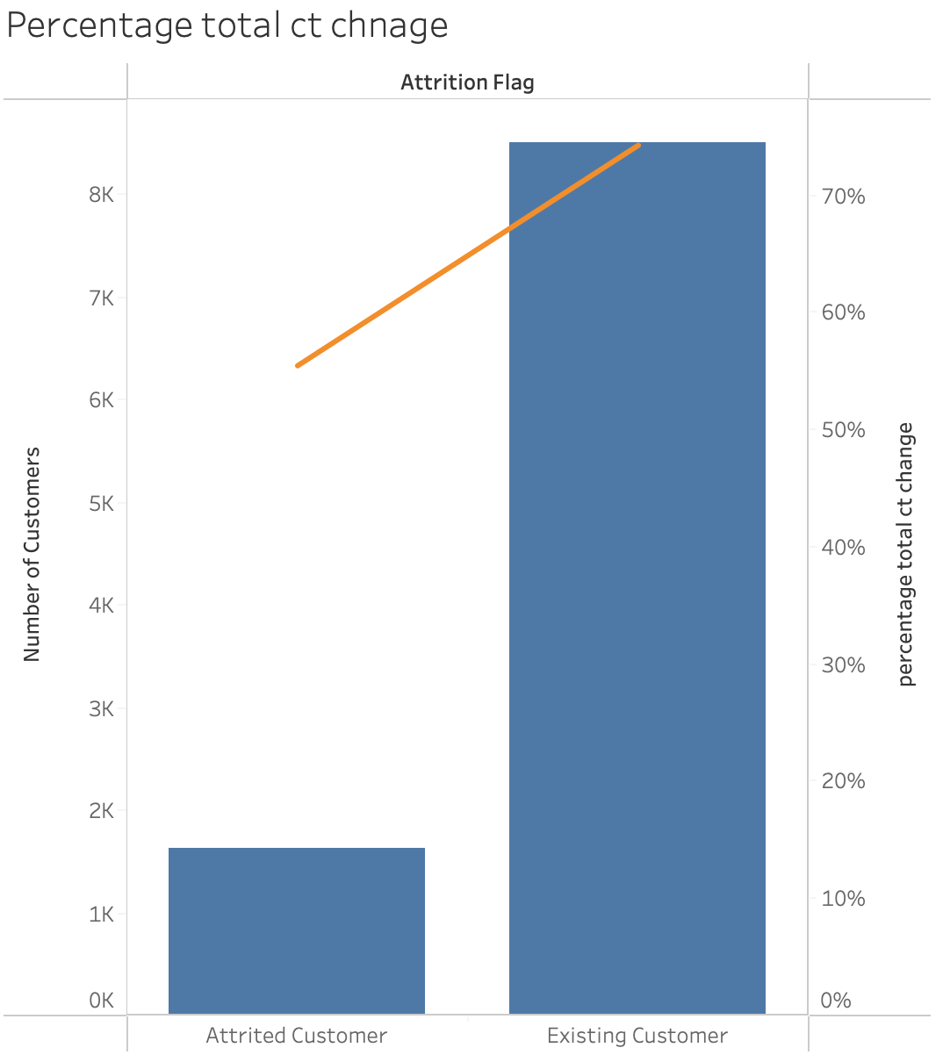
Total Amount Change (Q1-Q4):
T stat is > t critical at 13.3 and p-value is < 0.05 indicating significance of total amount change in predicting attritions.
Attrited Customers have lower % of change in total amount of transactions (69%) vs. (77%) for Existing customers, indicating that customers having none to few changes are more likely to churn.
Total Count Change (Q1-Q4):
T stat is > t critical at 30.5 and p-value is < 0.05 indicating significance of total count change in predicting attritions.
Attrited Customers have lower % of change in total count of transactions (55%) vs. Existing customers (74%), indicating that customers having none to few changes are more likely to churn.

Slide 7
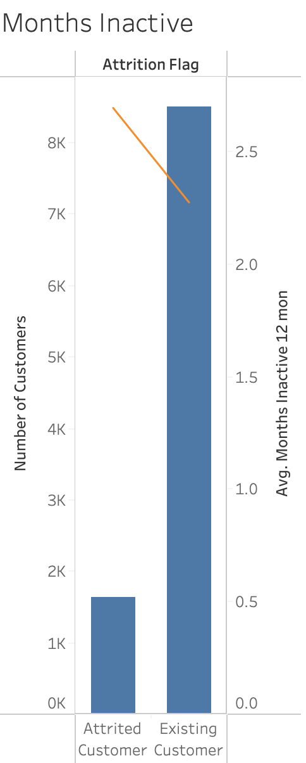
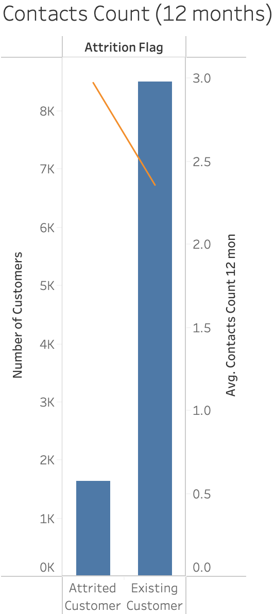
Inactivity (last 12 months):
T stat is > t critical at - 15.5 and p-value is < 0.05 indicating significance of inactivity in the last 12 months in predicting attritions.
Attrited Customers have longer avg inactivity periods in the last 12 months (2.7) vs. Existing customers (2.3), indicating that customers with longer inactivity periods are more likely to churn.
Total Number of Contacts (last 12 months):
T stat is > t critical at - 21.02 and p-value is < 0.05 indicating significance of total number of contacts in the last 12 months in predicting attritions.
Attrited Customers have a higher avg contacts count the last 12 months (2.9) vs. Existing customers (2.3), indicating that customers contacting the bank more than others are more likely to churn.

Slide 8
Categorical Variables Information Value

Slide 9
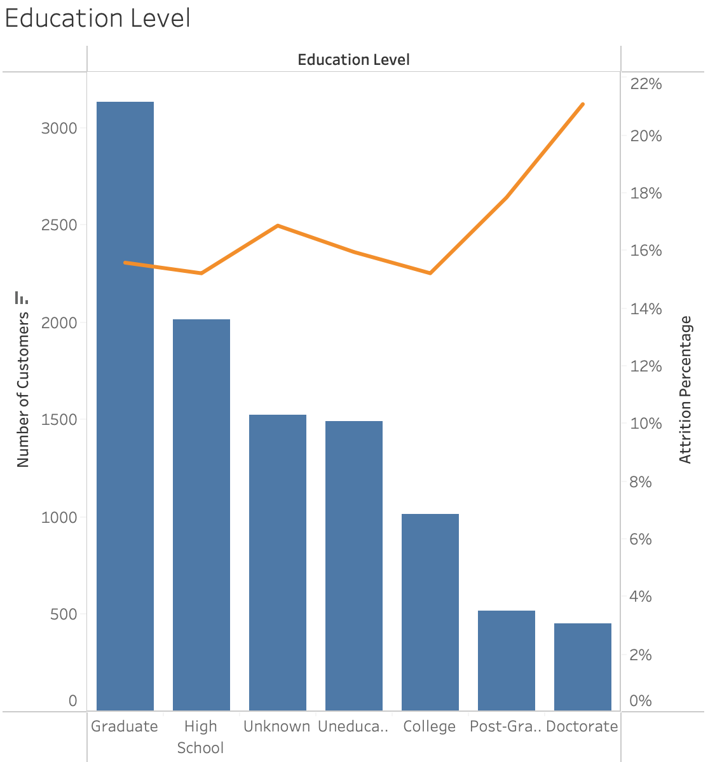
Education Level
Education Level has an IV of 0.04 indicating that it could be a weak predictor for attritions.
While Doctorate educated customers have the highest attrition percentage (21%), they are the lowest in number (4%) of total customers. Customers with Graduate education have the highest number of customers (31%) of total customers and a high attrition percentage (16%), indicating that graduate customers are more likely to churn.

Slide 10
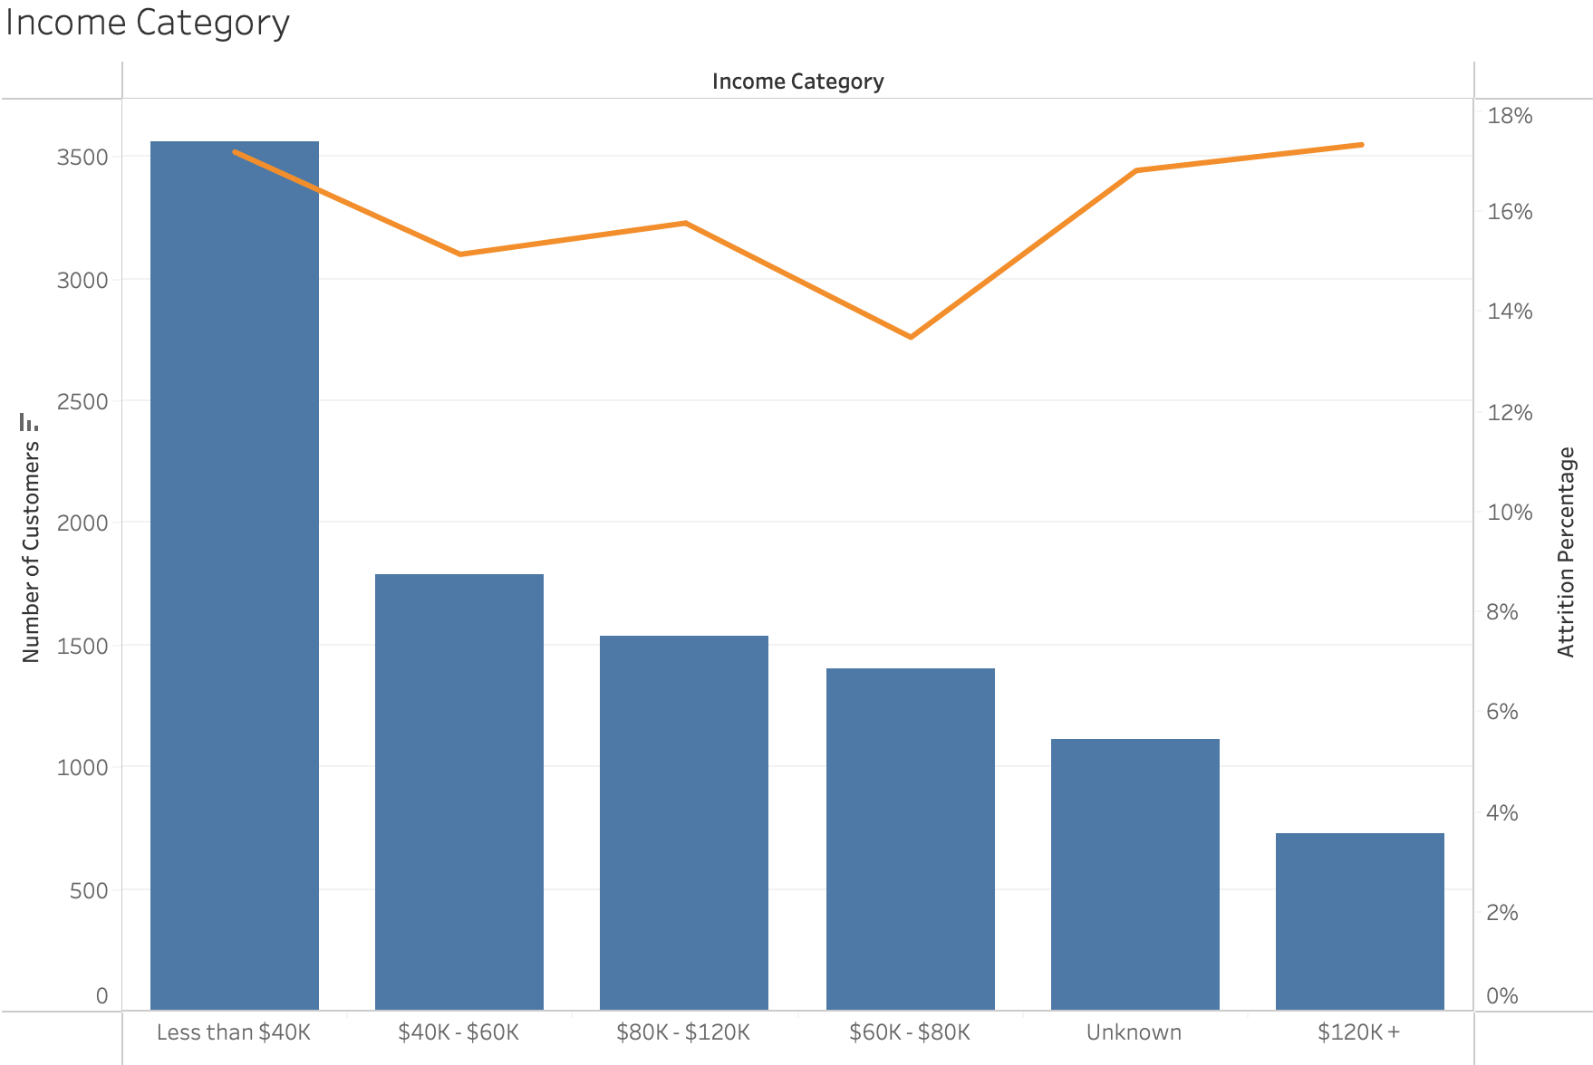
Income Category
Income Category has an IV of 0.02 indicating that it could be a weak predictor for attritions.
While customers making $120K+ have the same attrition percentage (17%) as those making <$40K , they are the lowest in number (7%) of total customers. Customers making <$40K represent (35%) of total customers and have a (17%) attrition percentage, indicating that graduate customers are more likely to churn.

Slide 11
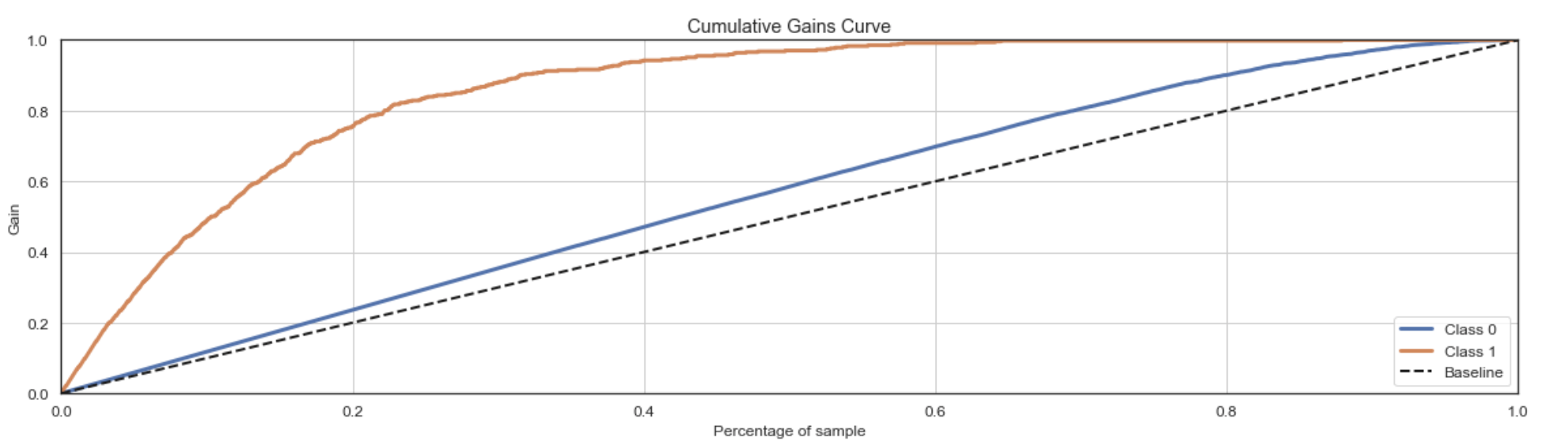
Value of Predictive Model
If we approached 20% of our customer base, we would be able to recall 20% of customers attrition, but if we reach out to top 20% of customers using model score, we would be able to recall almost 78% of actual attritions improving the marketing ROI by 4 times.

